Slide 1
Graph Database and its Applications
Amanjeet Singh Bhatia (2K11/CO/020)
Aviral Takkar (2K11/CO/031)
Ayush Chaudhary (2K11/CO/032)
Ayush Ravi Rai (2K11/CO/033)

Slide 2
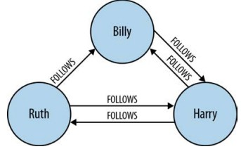
Graphs Are Everywhere
A graph is a collection of vertices and edges—or, a set of nodes and the relationships that connect them.
Graphs represent entities as nodes and the ways in which those entities relate to the world as relationships.
For data of any significant size or value, graph databases are the best way to represent and query connected data.
Connected data is data whose interpretation and value requires us first to understand the ways in which its constituent elements are related.
Figure 1. A small social graph

Slide 3
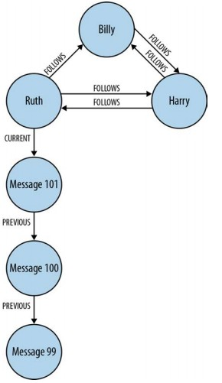
The Property Graph Model
A property graph has the following characteristics:
• It contains nodes and relationships
• Nodes contain properties (key-value pairs)
• Relationships are named and directed, and always have a start and end node
• Relationships can also contain properties
Figure 2. The expressive power of the graph model: It’s easy to see that Ruth has published a string of messages. The most recent message can be found by following a relationship marked CURRENT; PREVIOUS relationships then create a time
line of posts.

Slide 4
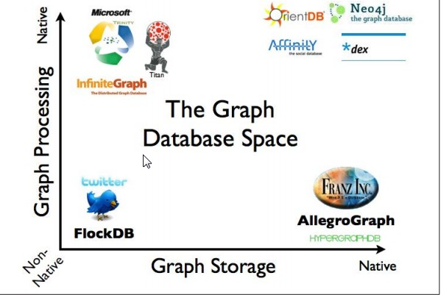
Graph Databases
A graph database management system is an online database management system with Create, Read, Update, and Delete (CRUD) methods that expose a graph data model.
Figure 3. (Graph Database Space)
Important Properties
The underlying storage: maybe be “native graph storage” or other general purpose data store.
The processing engine

Slide 5
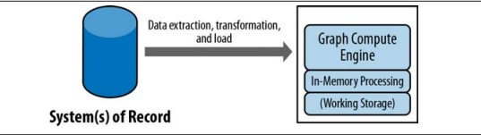
Graph Compute Engines
A graph compute engine is a technology that enables global graph computational algorithms to be run against large datasets.
Figure 4. Common architecture for deploying a graph compute engine
The architecture includes a system of record (SOR) database with OLTP properties (such as MySQL, Oracle, or Neo4j), which serves, requests, and responds to queries from the application at runtime. Periodically, an Extract, Transform, and Load (ETL) job moves data from the system of record database into the graph compute engine for offline querying and analysis.
Notes:
Online transaction processing, or OLTP, is a class of information systems that facilitate and manage transaction-oriented applications, typically for data entry and retrieval transaction processing.

Slide 6
Characteristics and Advantages
The sheer performance increase when dealing with connected data versus relational databases and NOSQL stores. In contrast to relational databases, where join-intensive query performance deteriorates as the dataset gets bigger, with a graph database performance tends to remain relatively constant, even as the dataset grows. This is because queries are localized to a portion of the graph, hence, the execution time for each query is proportional only to the size of the part of the graph traversed to satisfy that query, rather than the size of the overall graph.
Flexibility. We can add new kinds of relationships, new nodes, and new sub-graphs to an existing structure without disturbing existing queries and application functionality.
Agility. The schema-free nature of the graph data model, coupled with the testable nature of a graph database’s application programming interface (API) and query language, empower us to evolve an application in a controlled manner.

Slide 7
Neo4j
What is Neo4j? Neo4j is an open-source graph database supported by Neo Technology.
Neo4j stores data in nodes connected by directed, typed relationships with properties on both, also known as a Property Graph.
Main features
intuitive, using a graph model for data representation.
reliable, with full ACID transactions.
durable and fast, using a custom disk-based, native storage engine.
massively scalable, up to several billion nodes/relationships/properties.
highly-available, when distributed across multiple machines.
expressive, with a powerful, human readable graph query language (Cypher).
fast, with a powerful traversal framework for high-speed graph queries.
embeddable, with a few small jars.
simple, accessible by a convenient REST interface or an object-oriented Java API
Notes:
ACID (Atomicity, Consistency, Isolation, Durability) is a set of properties that guarantee that database transactions are processed reliably.
REST (REpresentational State Transfer) is a simple stateless architecture that generally runs over HTTP.
REST involves reading a designated Web page that contains an XML file. The XML file describes and includes the desired content.
REST is often used in mobile applications, social networking Web sites, mashup tools and automated business processes. The REST style emphasizes that interactions between clients and services is enhanced by having a limited number of operations (verbs). Flexibility is provided by assigning resources (nouns) their own unique universal resource indicators (URIs). Because each verb has a specific meaning (GET, POST, PUT and DELETE), REST avoids ambiguity.

Slide 8
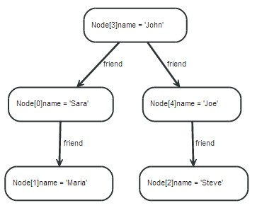
Cypher
Cypher is a declarative graph query language.
Cypher borrows it structure from SQL — queries are built up using various clauses.
Figure 5. An example graph.
Here are a few clauses used to read from the graph
MATCH: The graph pattern to match. This is the most common way to get data from the graph.
WHERE: Not a clause in it’s own right, but rather part of MATCH, OPTIONAL MATCH and WITH. Adds constraints to a pattern, or filters the intermediate result passing through WITH.
RETURN: What to return.

Slide 9
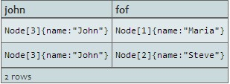
For example, here is a query which finds a user called John and John’s friends (though not his direct friends) before returning both John and any friends-of-friends that are found.
MATCH (john {name: 'John'})-[:friend]->()-[:friend]->(fof)
RETURN john, fof
Resulting in:

Slide 10
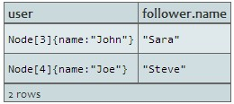
As another example, we take a list of user names and find all nodes with names from this list, match their friends and return only those followed users who have a name property starting with S.
MATCH (user)-[:friend]->(follower)
WHERE user.name IN ['Joe', 'John', 'Sara', 'Maria', 'Steve'] AND follower.name =~ 'S.*'
RETURN user, follower.name
Resulting in:
Some update clauses are:
CREATE (and DELETE): Create (and delete) nodes and relationships.
SET (and REMOVE): Set values to properties and add labels on nodes using SET and use REMOVE to remove them.
MERGE: Match existing or create new nodes and patterns. This is especially useful together with uniqueness constraints.

Slide 11
What we propose to do
Implementing a graph search for Twitter using Neo4j.
The objective is to design a user friendly web interface, where in the user may enter queries of the following nature:
My friends living in India and US
Followers living in Delhi and where follower count in 200
We plan to obtain the following information about the signed in user from the Twitter API:
Friends
Followers
Location
Follow count

Slide 12
What we propose to do
This information about the user would then be stored as a graph implemented in the Neo4j database.
The query given by the user will first have to be parsed and transformed to an equivalent Cypher query.
The grammar we would be employing for this purpose is as follows:
start ->friend | follower
follower -> "Followers" cond | "My Followers" cond
friend -> "Friends" cond | "My Friends" cond
cond -> (specificCond "and" cond | specificCond "or" cond | specificCond | empty)
specificCond -> placeCond | followCond
placeCond -> "living in" place
place -> Word
followCond -> "where follower count is" followCount
followCount -> Word(digits)

Slide 13
What we propose to do
The parsing of the query would be done using an open source parsing library in Python, called PyParsing.
Using functions from this library, the user entered query will be parsed and converted into its equivalent Cypher query, which will take the following general form:
MATCH var ({name: <username>})-[<friend> or <follower>]->() <etcetera>result
WHERE <user entered condition>
RETURN var,result

Slide 14
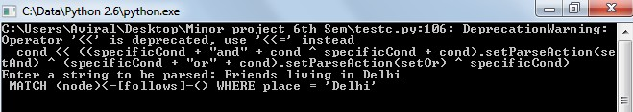
What we propose to do
An example of this parsing can be seen here.
This query would then be passed on to the Neo4j database server using its wrappers available in Python.
The server would run the query on the database and return the results which would then be displayed to the user.

Slide 15
Thank you!

